Slide 1
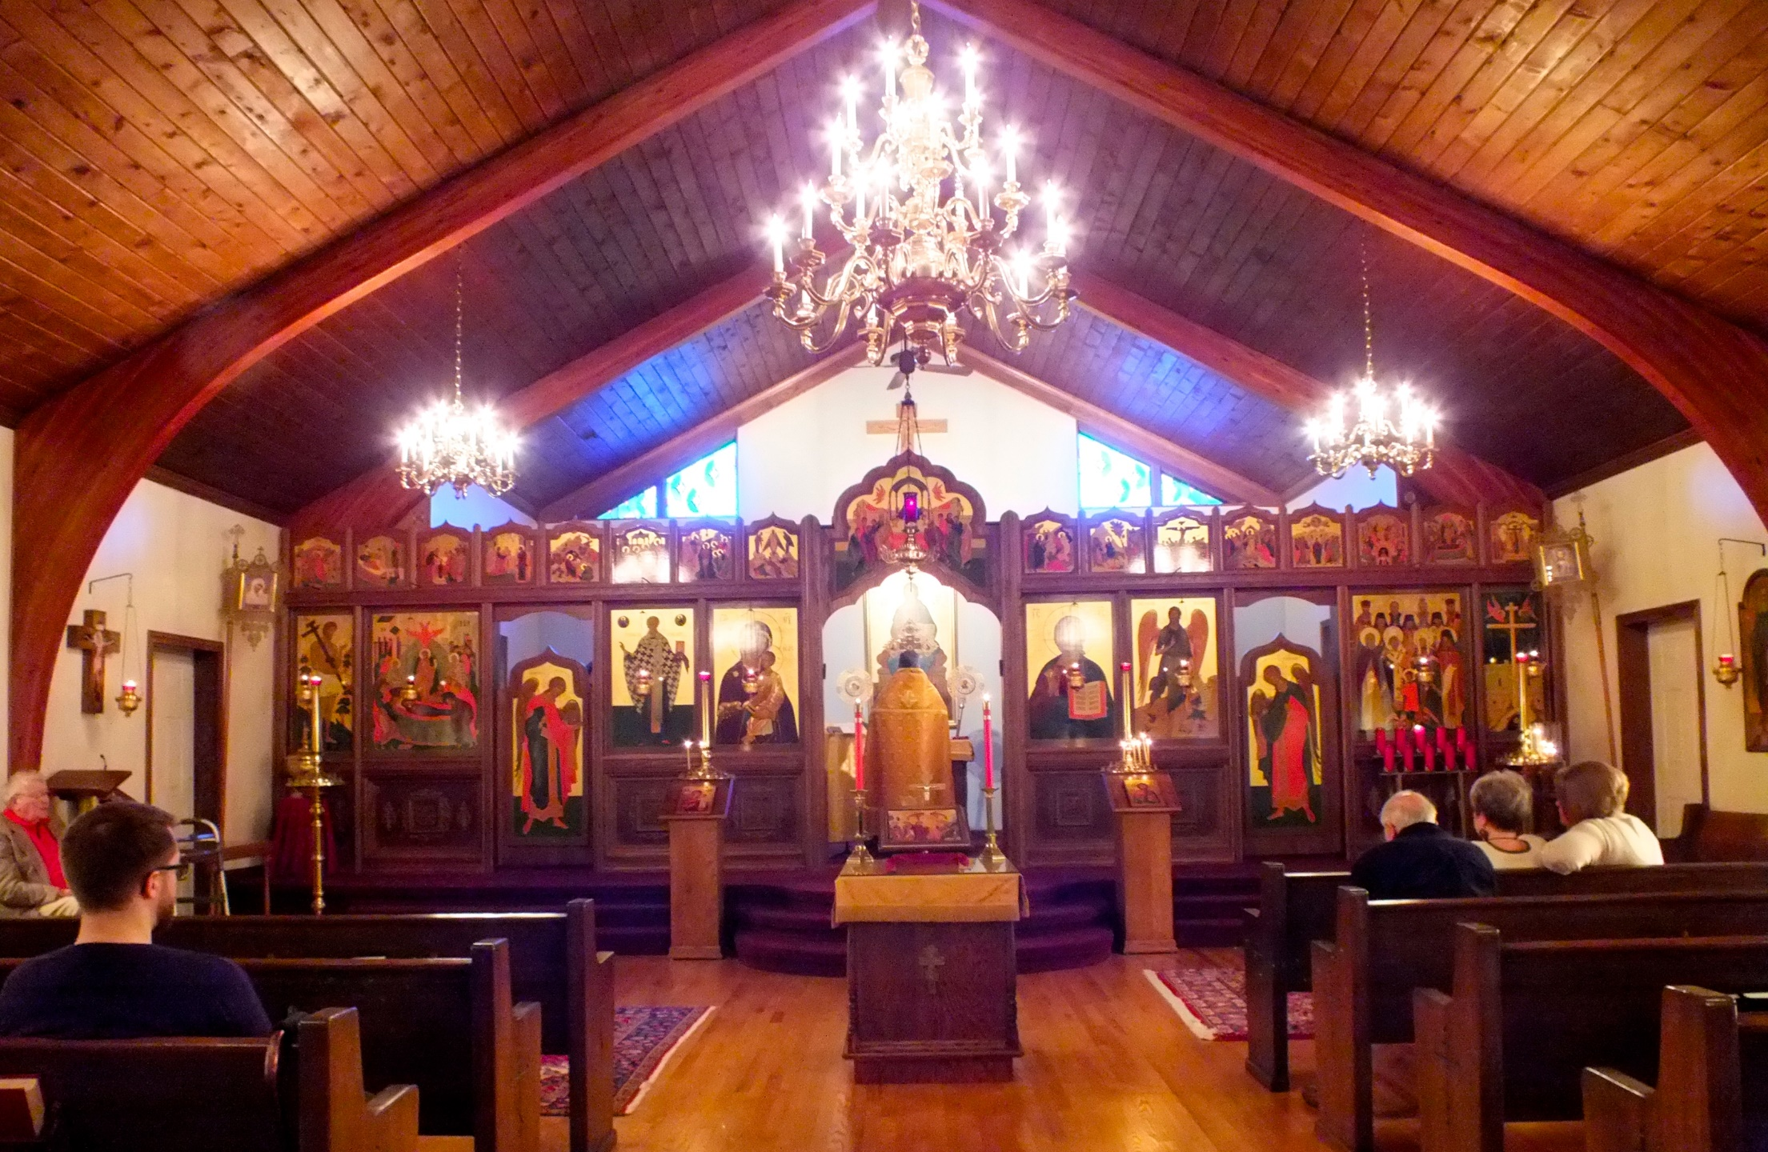
The Small Parish:
Possibilities & Opportunities
Worshipping, Caring, Teaching, Sharing
July 14-16, 2016

Slide 2
Welcome & Thank You!
Your time this week
Your past labors
Your willingness to consider new approaches
Notes:
Principles and applications that follow may come as a change in focus and direction for many of you dedicated people.

Slide 3
Thank You!
Your time this week
Your past labors
Your willingness to consider new approaches
Also to our Supporting OCA Dioceses
Archdiocese of Pittsburgh
and Western Pennsylvania
Diocese of Chicago and the Midwest
Notes:
Principles and applications that follow may come as a change in focus and direction for many of you dedicated people.

Slide 4
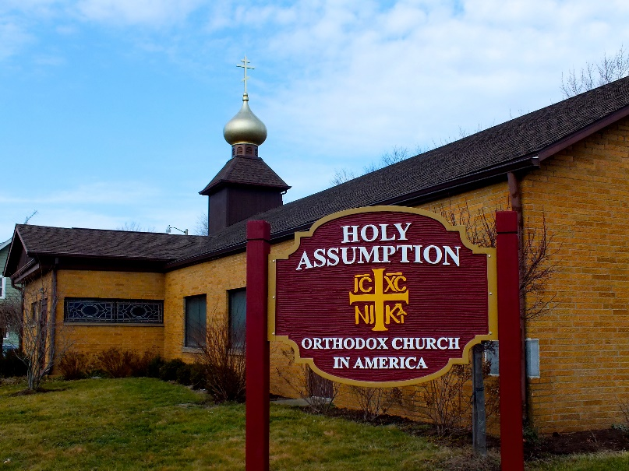
Thank You!
Your time this week
Your past labors
Your willingness to consider new approaches
And too Our Hosts!
Notes:
Principles and applications that follow may come as a change in focus and direction for many of you dedicated people.

Slide 5
Forum Goals
For attendees to leave committed and able to take appropriate next steps in your parish.
Stimulate Commitment to Stewardship of Future
Offer Worship & Leadership Tools
Establish Communication Networks
Collaborate to Reduce Stress – Share Burden

Slide 6
Faculty & Staff
Clergy
Laypersons
Fr Eric Tosi
Fr. Daniel Mathewson
Fr. Justin Patterson
FR Peter Baktis
Fr. Marc Vranes
In absentia…
Fr Paul Albert
Fr. Jonathan Bannon
Benedict Sheehan
Cathy Vrugitz
Joseph Kormos

Slide 7
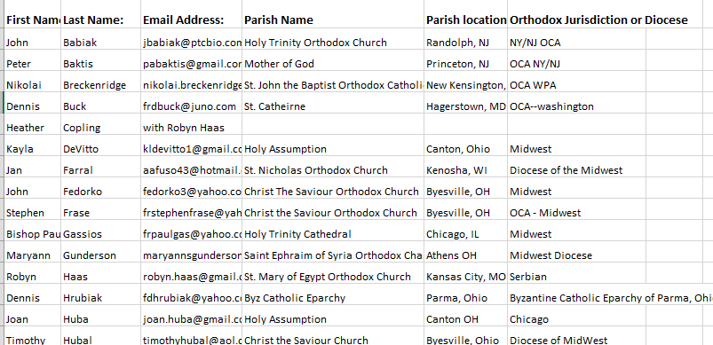
Attendees
Ohio
Pennsylvania
Connecticut
New Jersey
New York
Maryland
Illinois
Kentucky
Missouri
Oregon
OCA: South; NY/NJ; NE; EPA; Albanian
GOA
Ukrainian
Serbian
Byzantine Catholic Eparchy of Parma

Slide 8
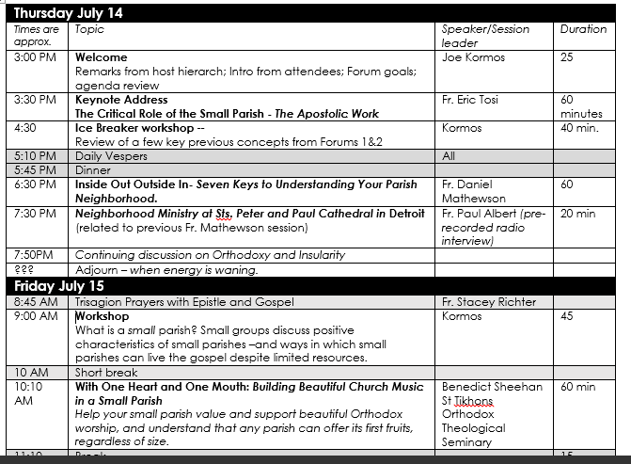
Agenda
Presentations
Discussions
Workshops

Slide 9
Which is Better?
Each is different.
Both are valuable

Slide 10
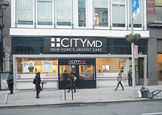
Same?
Clinic
Hospital

Slide 11
Theme
The Premise
Small parishes are not malnourished, immature versions of large parishes.
They think feel and act different. Yet, they can worship well, care for one another, teach, serve their community and share Christ’s love with others. Doing so requires they harness the intimacy and close relationships inherent in their modest size -- AND avoid using their size as an excuse for inactivity and mediocrity.
Are You Satisfied?
The Small Parish: Possibilities & Opportunities
Worshipping, Caring, Teaching, Sharing
Do You Feel Inferior?

Slide 12
What Do You Need to Learn/Accomplish to Make Your Attendance Worthwhile?

Slide 13
Questions We Will Tackle
Are there advantages to being small?
Do small parishes need to grow?
What is a viable parish?
What are some of the good practices of small parishes that are building for a future?
Could this work for us?
How can we engage our neighborhood?
How can we build beautiful worship in our small parish?
How can provide education experiences even though we are small?
Must clergy be ‘full time’? Role of tent makers? What do we lose with that model?
What skills & motivations are necessary for us to share our faith?
If you learn something valuable here –what will you do with it? How will you plant seeds back home?
What are two goals for our parish in next 6-18 months?

Slide 14
The Joharry Window
Do
Don’t Do
Reinforce
Consider
Implementing
Know
Don’t
Know
Explore applicability
Graphic #3

