Slide 1
Users Manual
This is NOT
A full catechism.
An adult ed. class for parishioners.
Designed to convince someone to convert or return to the Church.
It is:
Designed for three short evening classes. Why three? Arbitrary. (Also, if you have to ask “why three?” you definitely need this class!)
Designed to generate an appetite for more …eventually, perhaps leading to catechesis
Be delivered by priests, deacons and/or lay catechists
Assumed attendees are from a variety of backgrounds. It is not tuned to specific interests of a particular audience.
Assumes that we have a class (group environment) not an individual learner.
You can customize this as much as you want.
Add your parish name, location
Use local photos.
Delete this slide before presenting. (But you knew that!)
Hope this effort is helpful. If so tell your friends. If not tell me. Pass on ideas for other topics
Thank you for interest. Joe Kormos 513-683-1911

Slide 2
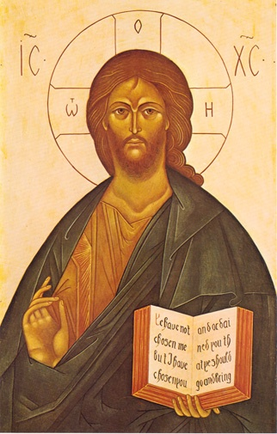
Introduction to Orthodox Christianity
A Three Session Class
for Inquirers

Slide 3
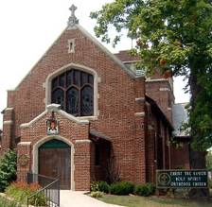
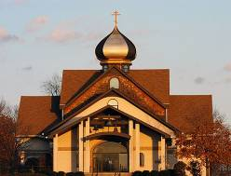
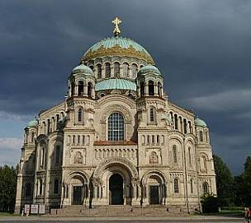
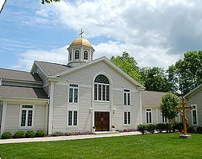
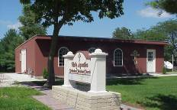
Class Purpose
Provide a basic introduction to Orthodox Christianity

Slide 4
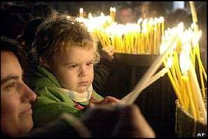
Questions We Will Answer
What is the Orthodox Church?
Where does it come from – and why have so many never heard of it?
How is it similar to and different from Christian Churches with which you may be more familiar?
What do people find here?
Your specific questions.

Slide 5
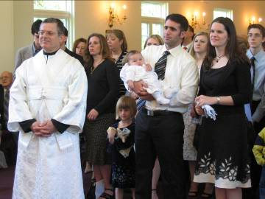
Overview
Welcome!
Coffee and soft drinks afterwards
We love questions…ask them anytime
The restrooms are located…
Session Outline
Introduction to Orthodox Christianity
Session 1 - Who We Are
Session 2 - What We Believe
Session 3 - How We Live

Slide 6
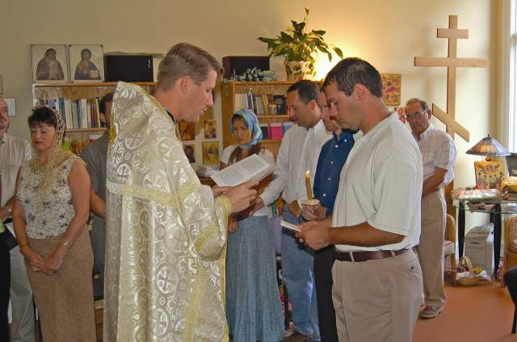
Orthodox Christianity Who We Are
Session 1

Slide 7
Orthodox Christian Church
IS NOT
an institution or organization
IS
a Living Organism –the people of God
As the people of God we:
Gather together in his name
Share a common faith in love of God
Affirm truth & fullness of their faith belief & experience
Proclaim the Good News of Christ in word and deed

Slide 8
An Orthodox Christian…
A person who lives according to the image of Jesus Christ and affirms the fullness of truth he reveals
Ortho | dox |  | Christ | ian
True or correct complete doctrine | Belief teaching doctrine |  | Jesus Christ in whom our faith is rooted | One who strives to live as Christ did

Slide 9
Jesus Christ
DID NOT …
Come to establish a religion, belief system or code of ethics.
DID
Give us a model for living based on loving…
God with our very being
Others as we love ourselves
On this, Jesus Christ says, everything else hinges

Slide 10
Orthodox Christian Church
Origins
Traces its origins to Jesus Christ and the apostles
Born on day of Pentecost
50 days after Christ’s resurrection
when the Holy Spirit descended upon the Apostles
Apostles went throughout the world
proclaiming the Good News of the Risen Christ to all who would listen
Subsequently spread to every corner of the world
Planted in North America by Orthodox missionaries
Alaska, 1794

Slide 11
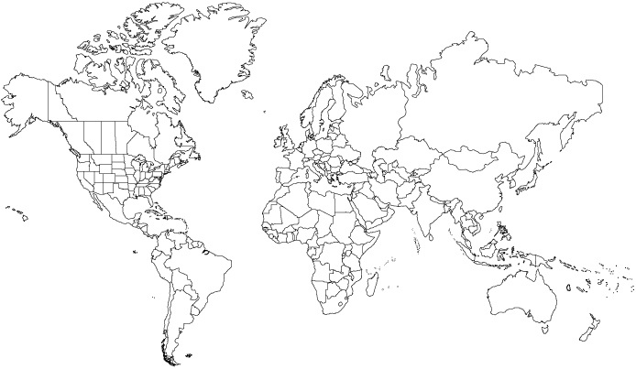
Orthodox Church Today
Throughout the world
300,000,000 Orthodox Christians
In North America
2,000,000 Orthodox Christians
2800 parishes, missions institutions and monasteries
The Church continues to invite people to
Come and see the fullness of the faith
Embrace it as their own

Slide 12
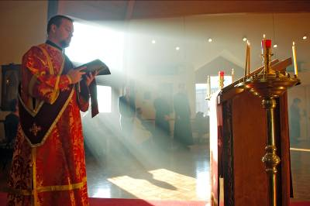
Orthodox Christians
Attempt to serve God by:
Worship
Public “liturgy” & private prayer

Slide 13
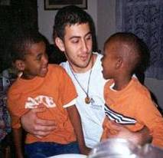
Orthodox Christians
Attempt to serve God by:
Fellowship
By interacting with others in the faith community and beyond

Slide 14
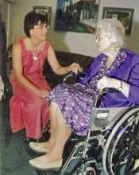
Orthodox Christians
Attempt to serve God by:
Discipleship
Fasting, almsgiving and reaching out to others, especially those in spiritual and material need

Slide 15
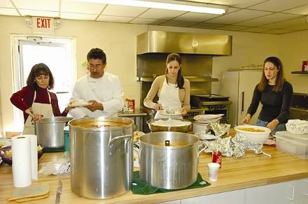
Orthodox Christians
Attempt to serve God by:
Stewardship
Wisely managing the gifts of time, talent and treasure with which God has blessed us.

Slide 16
Next Week
Session 2 – What We Believe

Slide 17
Questions?

Slide 18
Orthodox Christianity What We Believe
Session 2

Slide 19
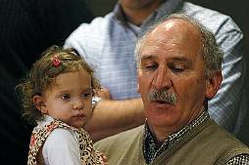
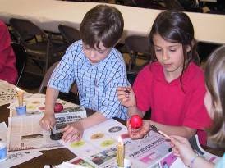
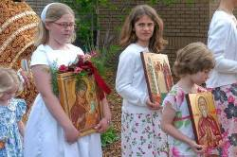
Topics
Scripture
Tradition
Trinity
The Church
Salvation

Slide 20
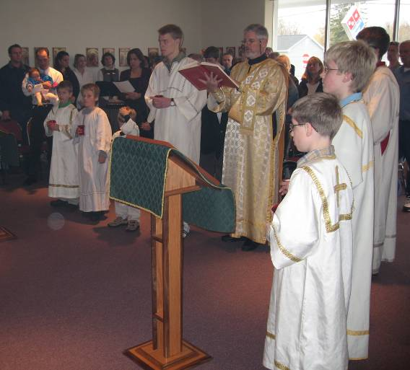
Holy Scripture
The inspired word of God and the written record of His revelation to humanity

Slide 21
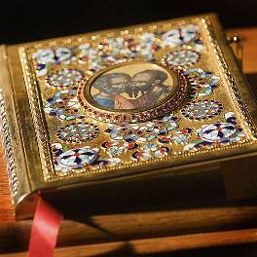
Holy Scripture
Old Testament
Records the manner in which God prepared the world for the coming of His Son, Jesus Christ.
New Testament
Completes and fulfills God’s revelation…
by proclaiming Jesus Christ as Lord, God and Savior;
as the very Word of God
Who came to live in the midst of His people;
and as the perfect, final and complete revelation of God to the world

Slide 22
Holy Tradition
That which is passed on or given over within the Church, from the time of Jesus Christ and the apostles until the present day
Is…
the ongoing life of God’s People
that which God’s People have believed, lived, experienced, celebrated and shared at all times and in all places.
the living link that unites God’s people in a common faith, life & experience.
Includes…
all that is essential to God’s revelation and necessary for our salvation

Slide 23
Holy Tradition
Consists of…
Holy Scripture
Prayer & liturgical worship
Accepted creeds & acts of the early Church’s councils
Writings of the Holy Fathers
Lives of the saints
Artistic and musical expression of the Church

Slide 24
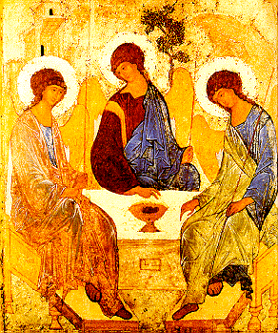
Holy Trinity
The one God is three separate and distinct Persons
Father, Son and Holy Spirit
Each Person of the Trinity…
Shares fully and equally in the divine nature and will AND
Is infinite, perfect, all knowing, ever existing and eternally the same AND
Is perfectly united to the other Persons of the Trinity in love.

Slide 25
Holy Trinity (cont’d)
God the Father
The source of all things
Maker of Heaven and Earth
And of all things visible and invisible
Summarized in Nicene Creed, professed unchanged since 4th century

Slide 26
Holy Trinity (cont’d)
God the Son, Jesus Christ
Sent by the Father into the world for our salvation
Begotten of the Father before all ages
Took on human nature & became man while not forsaking divine nature
Crucified for us under Pontius Pilate
and on the third day He arose again
He shall come again in glory to judge the living and the dead
Jesus Christ is our Savior,
who leads humanity into God’s kingdom

Slide 27
Holy Trinity (cont’d)
God the Holy Spirit
The Lord, the Giver of Life
Proceeds from the Father
Is worshipped and glorified with the Father and the Son
The Holy Spirit fills us, sustains us and strengthens us in living a Christ-like life

Slide 28
The Church
The Church is… | Because…
ONE | It is one body with one Head, Jesus Christ It cannot be divided or separated because Christ cannot be divided or separated It does not posses numerous branches that, while similar, are not the same
HOLY | the Holy Spirit dwells in God’s people as they respond to His call to salvation and eternal life
CATHOLIC | the Church is whole, complete, lacking in nothing & universal
APOSTOLIC | It maintains and continues in the apostles’ teaching, mission, ministry and experience

Slide 29
Salvation
The process by which we prepare to enjoy eternal life with God.
Ends our separation from God, enabling us to begin a new life in accordance with His will.

Slide 30
Salvation
For those who… | Spending eternity in His presence is…
Love God | Paradise Heaven A “fire that purifies”
Hate God or, Are indifferent to Him or, Refuse to place their faith in Him | Torment A “fire that burns”

Slide 31
Salvation
Is ultimately attained through an active faith
Free to accept or reject
By accepting faith we commit ourselves to:
Living our faith
Putting it into action
Recognizing God’s presence in others – even the least of the brothers

Slide 32
Next Week
Session 3 – How We Live

Slide 33
Questions?

Slide 34
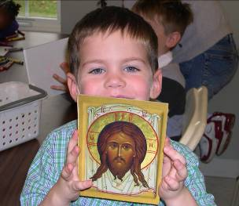
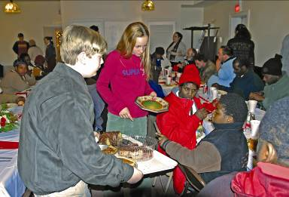
Orthodox Christianity How We Live
Session 3
Service to God Service to Others

Slide 35
How We Live
Offering service to others is rooted in service we offer to God in prayer and worship
Service to God
Service to
Others
Private Prayer
Public Worship
Sacraments
Fellowship
Discipleship
Stewardship

Slide 36
Service to God
Private prayer is essential
We communicate and commune with God personally
To discern God’s will for our lives
To obtain the means to live his will
To praise and thank him for the blessings He has given us
To bring our burdens before Him while asking for strength to live our faith even in times of adversity

Slide 37
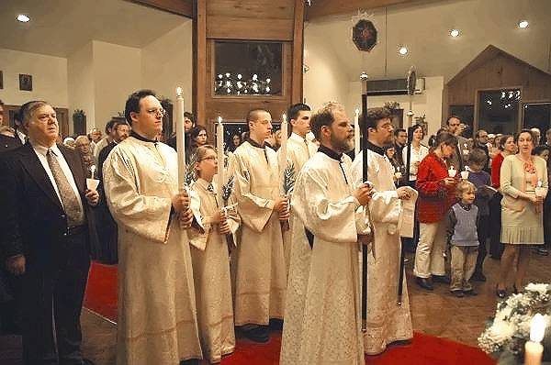
Service to God
Above all God’s people are a worshipping people
Liturgical Worship is…
the public proclamation of God as Lord
the common action, or liturgy, of God’s people

Slide 38
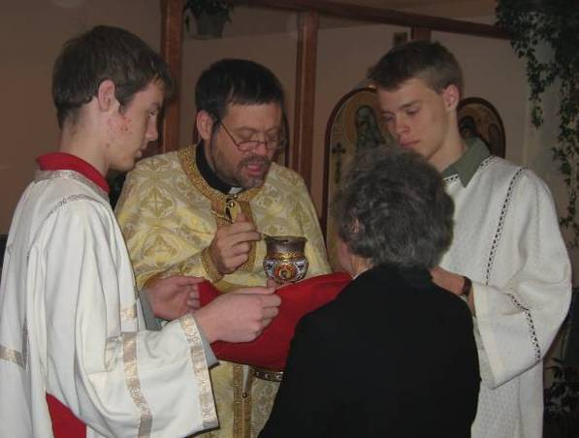
Service to God
The Divine Liturgy (Eucharist) is:
The central act of worship
During which we:
Proclaim God’s word as revealed in scripture
And respond in Thanksgiving through the reception of Holy Communion – the body and blood of Jesus Christ

Slide 39
Service to God
Sacraments
Our Sacraments | bring God’s presence into our lives as we:
Baptism & Chrismation | Become members of Christ’s Body
Holy Communion | Proclaim Christ’s death, Resurrection and Second Coming
Confession | Be forgiven by & reconciled with God and His People
Marriage | Share His love and the commitments it entails
Ordination | Dedicate our lives and our work to Him in specialized service
Holy Unction | Receive His healing grace

Slide 40
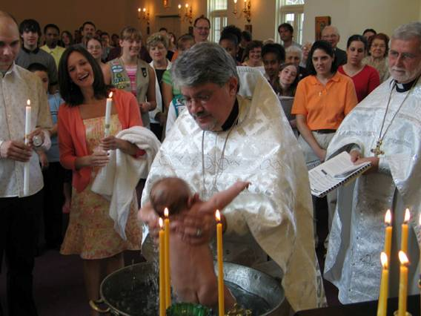
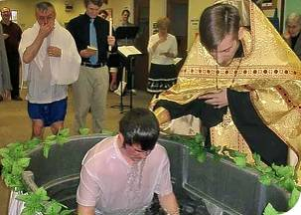
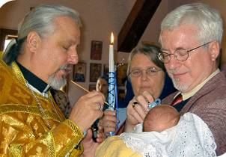
Service to God
Sacraments
Baptism & Chrismation
Become members of Christ’s Body

Slide 41
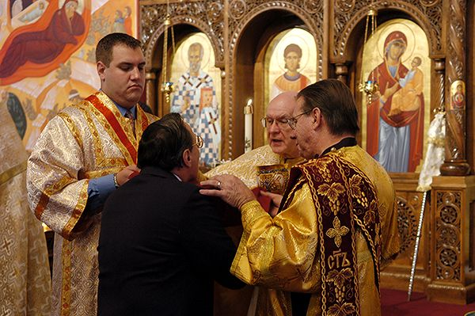
Service to God
Sacraments
Holy Communion
Proclaim Christ’s Death, Resurrection and Second Coming

Slide 42
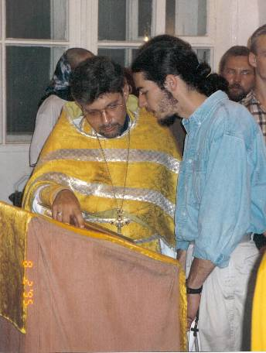
Service to God
Sacraments
Confession
Be forgiven by & reconciled with God and his people.

Slide 43
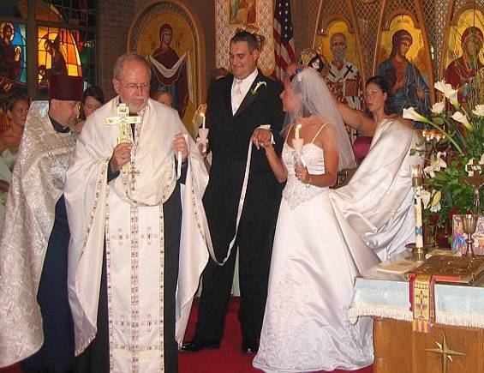
Service to God
Sacraments
Marriage
Share His love and the commitments it entails

Slide 44
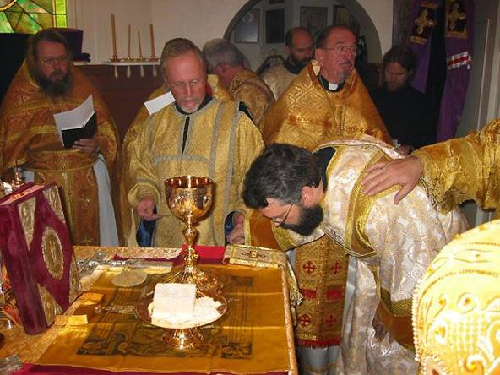
Service to God
Sacraments
Ordination
Dedicate our lives and our work to Him in specialized service

Slide 45
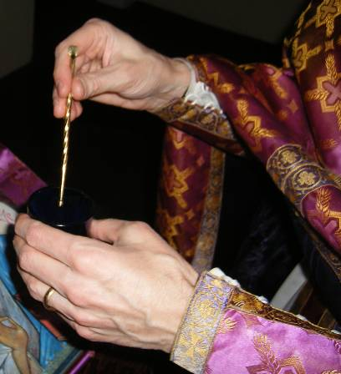
Service to God
Sacraments
Holy Unction
Receive his healing grace
“…unto the healing of soul and body.”
Notes:
Orthodox Christians should understand that the Sacrament of Holy Unction/Anointing with Oil at times of Sickness is not the “last right” for the faithful Christian. It is, rather, “unto the healing of soul and body.”
Pastoral solicitude for the sick is manifested in the celebration of the Mystery (Sacrament) of Holy Anointing which has its scriptural basis in Mark 6:13 and the Universal Epistle of St. James 5:1.

Slide 46
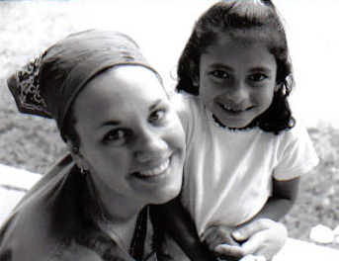
Service to Others
One cannot be a Christian independent of others
Volunteer and child at Hogar Rafael Ayau Orphanage
Guatemala City, Guatemala

Slide 47
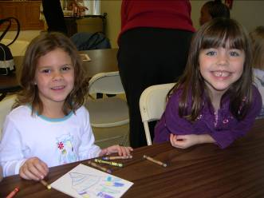
Service to Others
Fellowship
The Church is God’s people who:
Are united in a common faith, life and journey to the kingdom of God
Share their common union in the Christian community
The roots of fellowship are:
Mutual love & respect
Hospitality
Acknowledgement that, while we belong to Christ, we also are members of one another

Slide 48
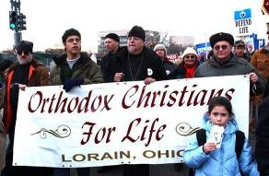
Service to Others (cont’d)
Discipleship
A disciple is more than a follower…
…rather a co-worker with Christ… bringing the Good News of salvation to all who listen and receive it.
Discipleship includes:
Strengthening our faith
Reading, studying, discussing
Living out our faith
In words and actions
Sharing our faith with others
Especially those who have yet to hear the fullness of the Good News of Jesus Christ

Slide 49
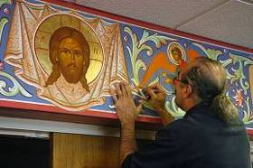
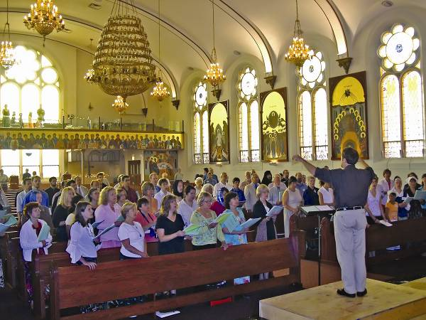
Service to Others (cont’d)
Stewardship
… wisely managing the countless gifts bestowed by God.
Time
Talent
Treasure
Notes:
Our Time
In fact our very lives and all life!
Our Talent
Those blessings that make us unique… so that in all we do God may be glorified
Our Treasure
Material possessions
bestowed by God… shared with others in need
Our Time
In fact our very lives and all life!
Our Talent
Those blessings that make us unique… so that in all we do God may be glorified
Our Treasure
Material possessions
bestowed by God… shared with others in need

Slide 50
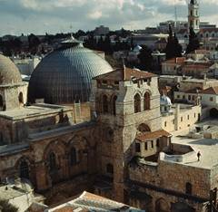
Summary
What Do People Find Here?
Doctrinal integrity and continuity with the original apostolic "deposit" that does not shift with the times or with prevailing fads.
Church of Holy Sepulchre
Jerusalem

Slide 51
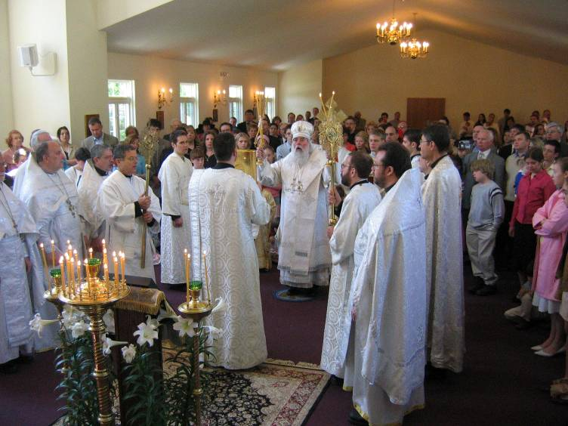
Summary
What Do People Find Here?
An emphasis on the experience and atmosphere of worship in which we acknowledge the holiness and majesty of God.

Slide 52
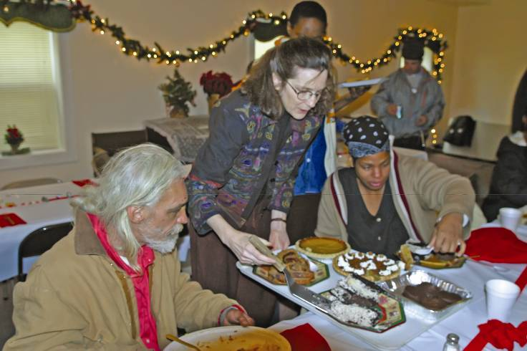
Summary
What Do People Find Here?
An over-all Christian "world view" that is meant to be lived out as a "way of life."

Slide 53
Thank You For Your Time and Your Attention!
Your Name Orthodox Church
Your Town or City
Customize this page!

